Slide 1
Northumberland Line Scheme Overview and Need Proof of Evidence of Stuart McNaughton
10th November 2021

Slide 2
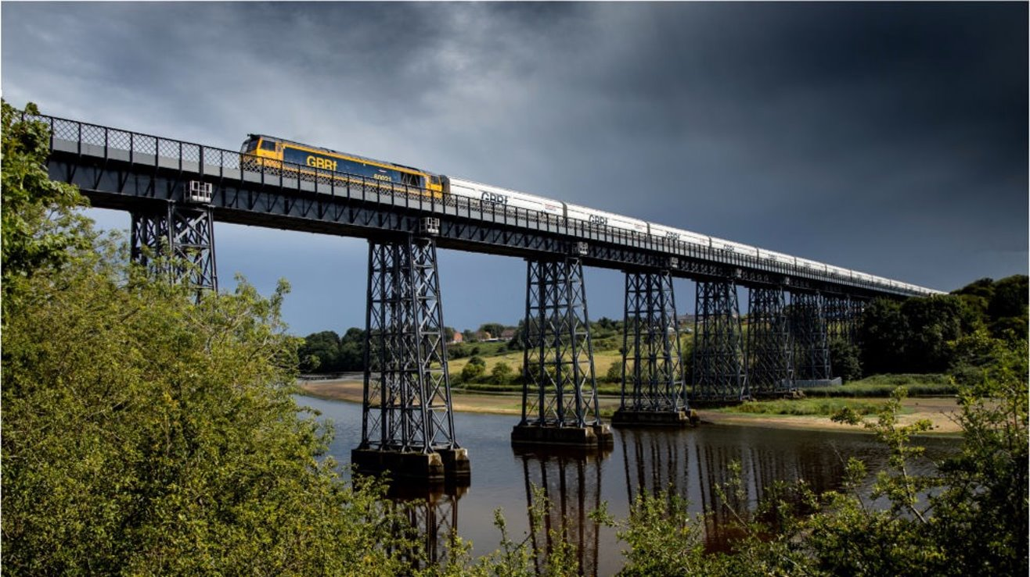
Summary of Proof of Evidence
Strategic Context and Need
Scheme Development
Scheme Description
Business Case
Social Value
Funding
Summary

Slide 3
Strategic Context and Need

Slide 4
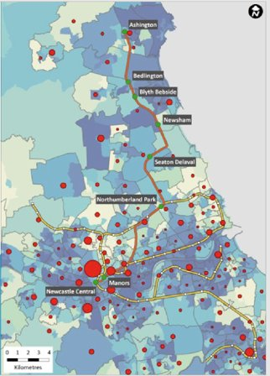
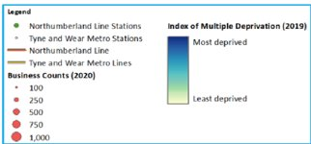
The Challenge
Significant deprivation and long-term unemployment exist along the Northumberland Line corridor
Tyne and Wear is a key destination for employment
Poor transport links compound this problem

Slide 5
Key Problems
Social deprivation - particularly at northern end of the line
Car Ownership – forecast to increase, further highway congestion
Mode Share – private motor car usage higher than the national average
Links of Economic Importance – uncompetitive journey times by public transport
Accessibility – lack of public transport options
Air Quality
Housing – consistent under delivery of housing across South East Northumberland

Slide 6
Regional Social Deprivation (2011 Census)
Factor | Base | Wansbeck | North East | England
People not in good health | Resident population (%) | 8.3 | 7.4 | 5.5
People with limiting long term illness | Resident population (%) | 23.4 | 21.6 | 17.6
Residents with no qualifications | Working Age Population (%) | 18.8 | 17.8 | 14.8
Population living in local authority or other social housing rented properties | Working Age Population (%) | 22.5 | 23 | 17.7

Slide 7
Households that do not own a car (2011 Census)

Slide 8
Journey Times to Key Employment Sites (AM Peak)
Origin | Destination | Bus Time (mins) | Car Time (mins) | Distance (miles)
Blyth (Central) | Newcastle city centre | 65 | 30 | 14.8
Blyth (Central) | Team Valley | 90 | 40 | 22.6
Blyth (Central) | Metrocentre | 85 | 35 | 18.9
Blyth (Central) | Cobalt Business Park | 46 | 18 | 9.1
Ashington (Central) | Newcastle city centre | 64 | 35 | 18.3
Ashington (Central) | Team Valley | 88 | 40 | 26.2
Ashington (Central) | Metrocentre | 94 | 35 | 22.5
Ashington (Central) | Cobalt Business Park | 72 | 20 | 14.7
Source: Google maps/traveline (highway journey times represent quickest routes, but journey times are variable)

Slide 9
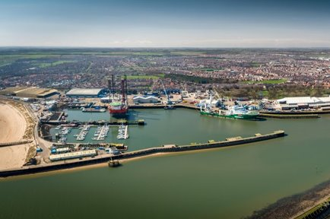
Opportunities
The Northumberland Line provides a catalytic opportunity to strengthen the whole region, and specifically South East Northumberland
British Volt “Gigafactory” at North Blyth – 3,000 new jobs
Port of Blyth
Cobalt Business Park

Slide 10
Scheme Development

Slide 11
Objectives
Facilitate economic activity, employment growth and the delivery of housing sites within South East Northumberland.
Create a 4% mode shift from car to public transport within the Northumberland Line corridor area, to improve local air quality and reduce highway congestion at key bottlenecks on the highway network between South East Northumberland, North Tyneside, and Newcastle.
Improve public transport accessibility for commuting, retail, and leisure trips between South East Northumberland, North Tyneside, and Newcastle by providing additional public transport options and reducing public transport journey times compared to the existing situation.

Slide 12
Options Considered
Improvements to express bus services from South East Northumberland into Tyne and Wear;
Personal travel planning at large employment sites across South East Northumberland;
Reopening of the existing freight line to heavy rail passenger services from South East Northumberland into Tyne and Wear; and
Extend Tyne and Wear Metro into South East Northumberland.

Slide 13
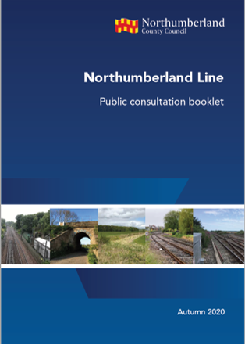
Consultation and Engagement
Scheme wide consultation – 2019 and 2020
2020 – 1,024 responses, 91% supportive
Consultation for individual station planning applications
Targeted engagement
COVID secure
Wide ranging stakeholder support

Slide 14
Scheme Description

Slide 15
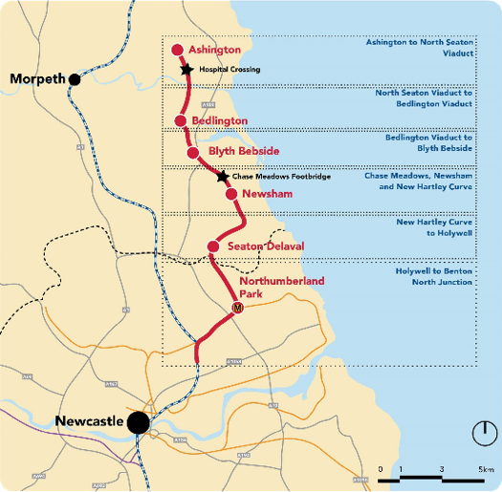
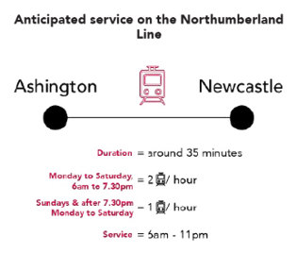
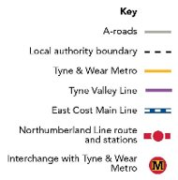

Slide 16
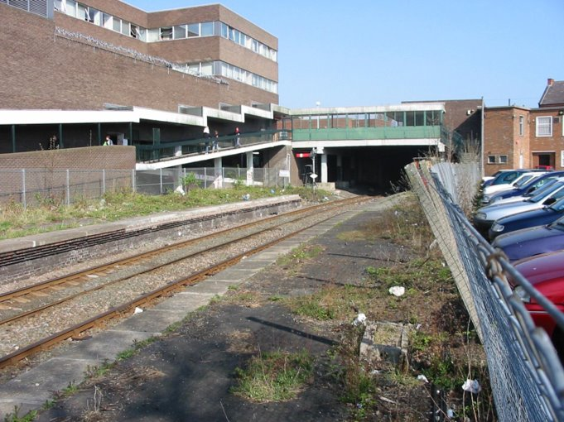
Ashington Station
36 min journey time to Newcastle Central
Former station site in centre of town
Maximises opportunities for access by sustainable modes
Key to town centre regeneration
Wansbeck Square and Portland Park developments
Connection to Northumberland College for South East Northumberland residents
Planning approval in place

Slide 17
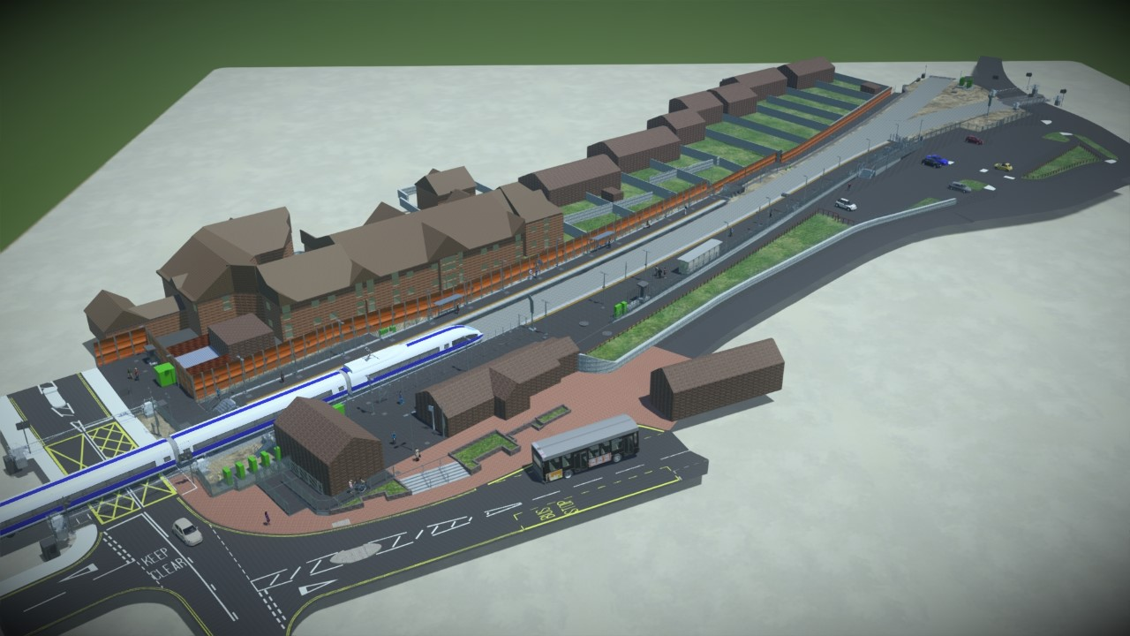
Bedlington Station
30 min journey time to Newcastle Central
Former station site in centre of town
Connections to strategic bus network
Key to town centre regeneration
Proximity to Britishvolt
Reuse of station buildings for community use
Planning approval in place

Slide 18
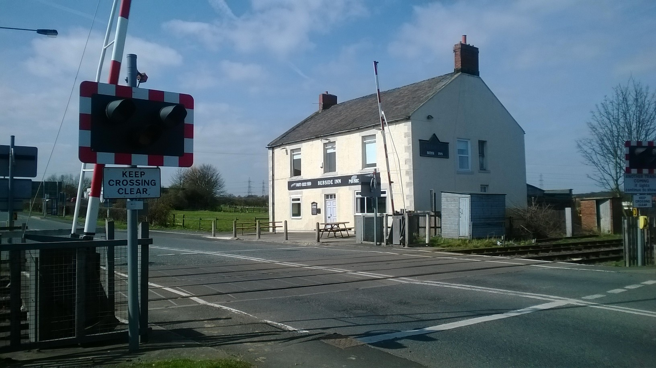
Bebside Station
27.5 min journey time to Newcastle Central
Strategic Park and Ride function (A189/A1068 corridor)
Access to Blyth Riverside Business Park and Chase Farm estate
Proximity of level crossing constraint on station location
Pedestrian and cycle footbridge to avoid A193/A189

Slide 19
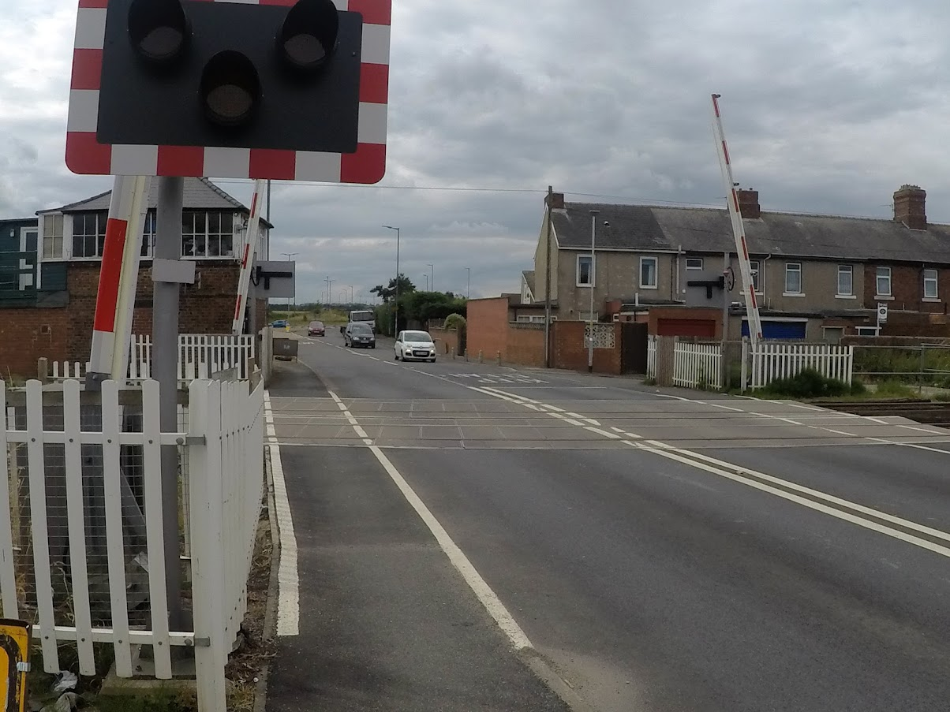
Newsham Station
23.5 min journey time to Newcastle Central
Key corridor between Blyth and Tyne and Wear conurbation
Good bus connectivity to town centre
Proximity to existing and future residential developments
Alternative sites considered

Slide 20
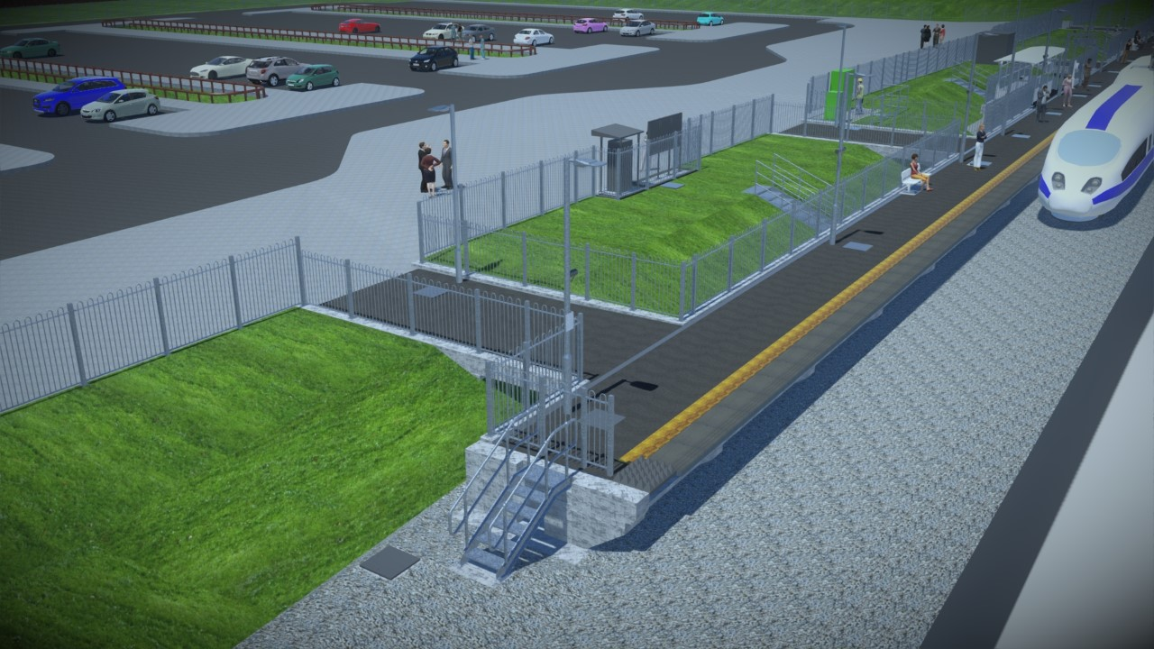
Seaton Delaval Station
20 min journey time to Newcastle Central
Station for whole of Seaton Valley (inc. Seghill and New Hartley) and east Cramlington
Alternative sites considered
Planning approval in place

Slide 21
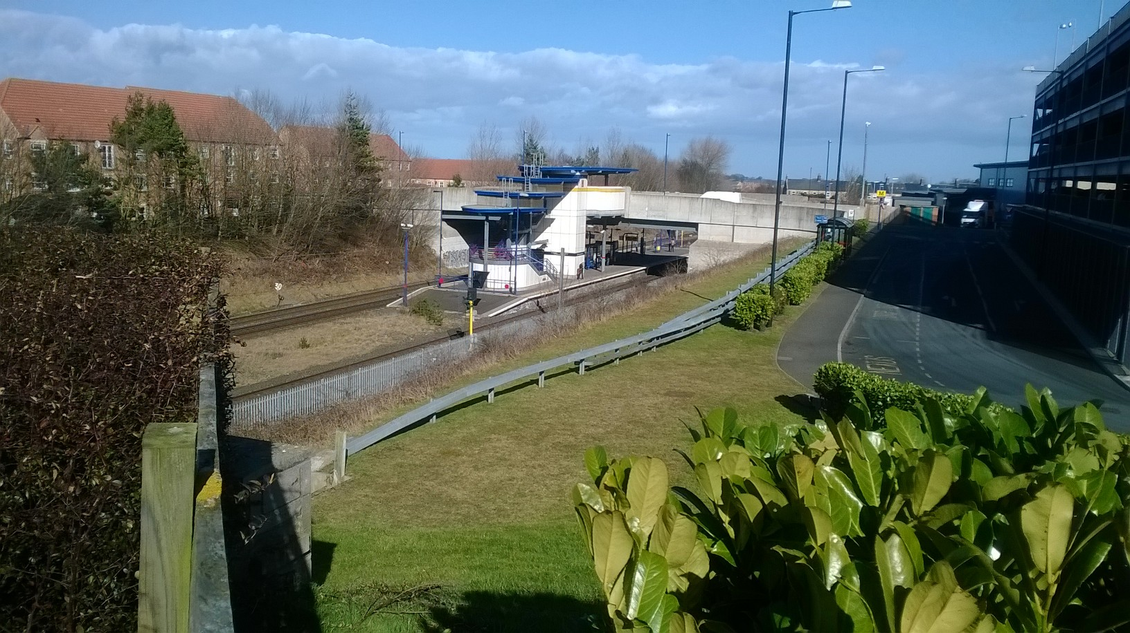
Northumberland Park
12.5 min journey time to Newcastle Central
Interchange with Tyne and Wear Metro
Onward connections to coast and airport
Proximity to Cobalt Business Park (1.6 million sq ft Grade A office space)
Planning approval in place

Slide 22
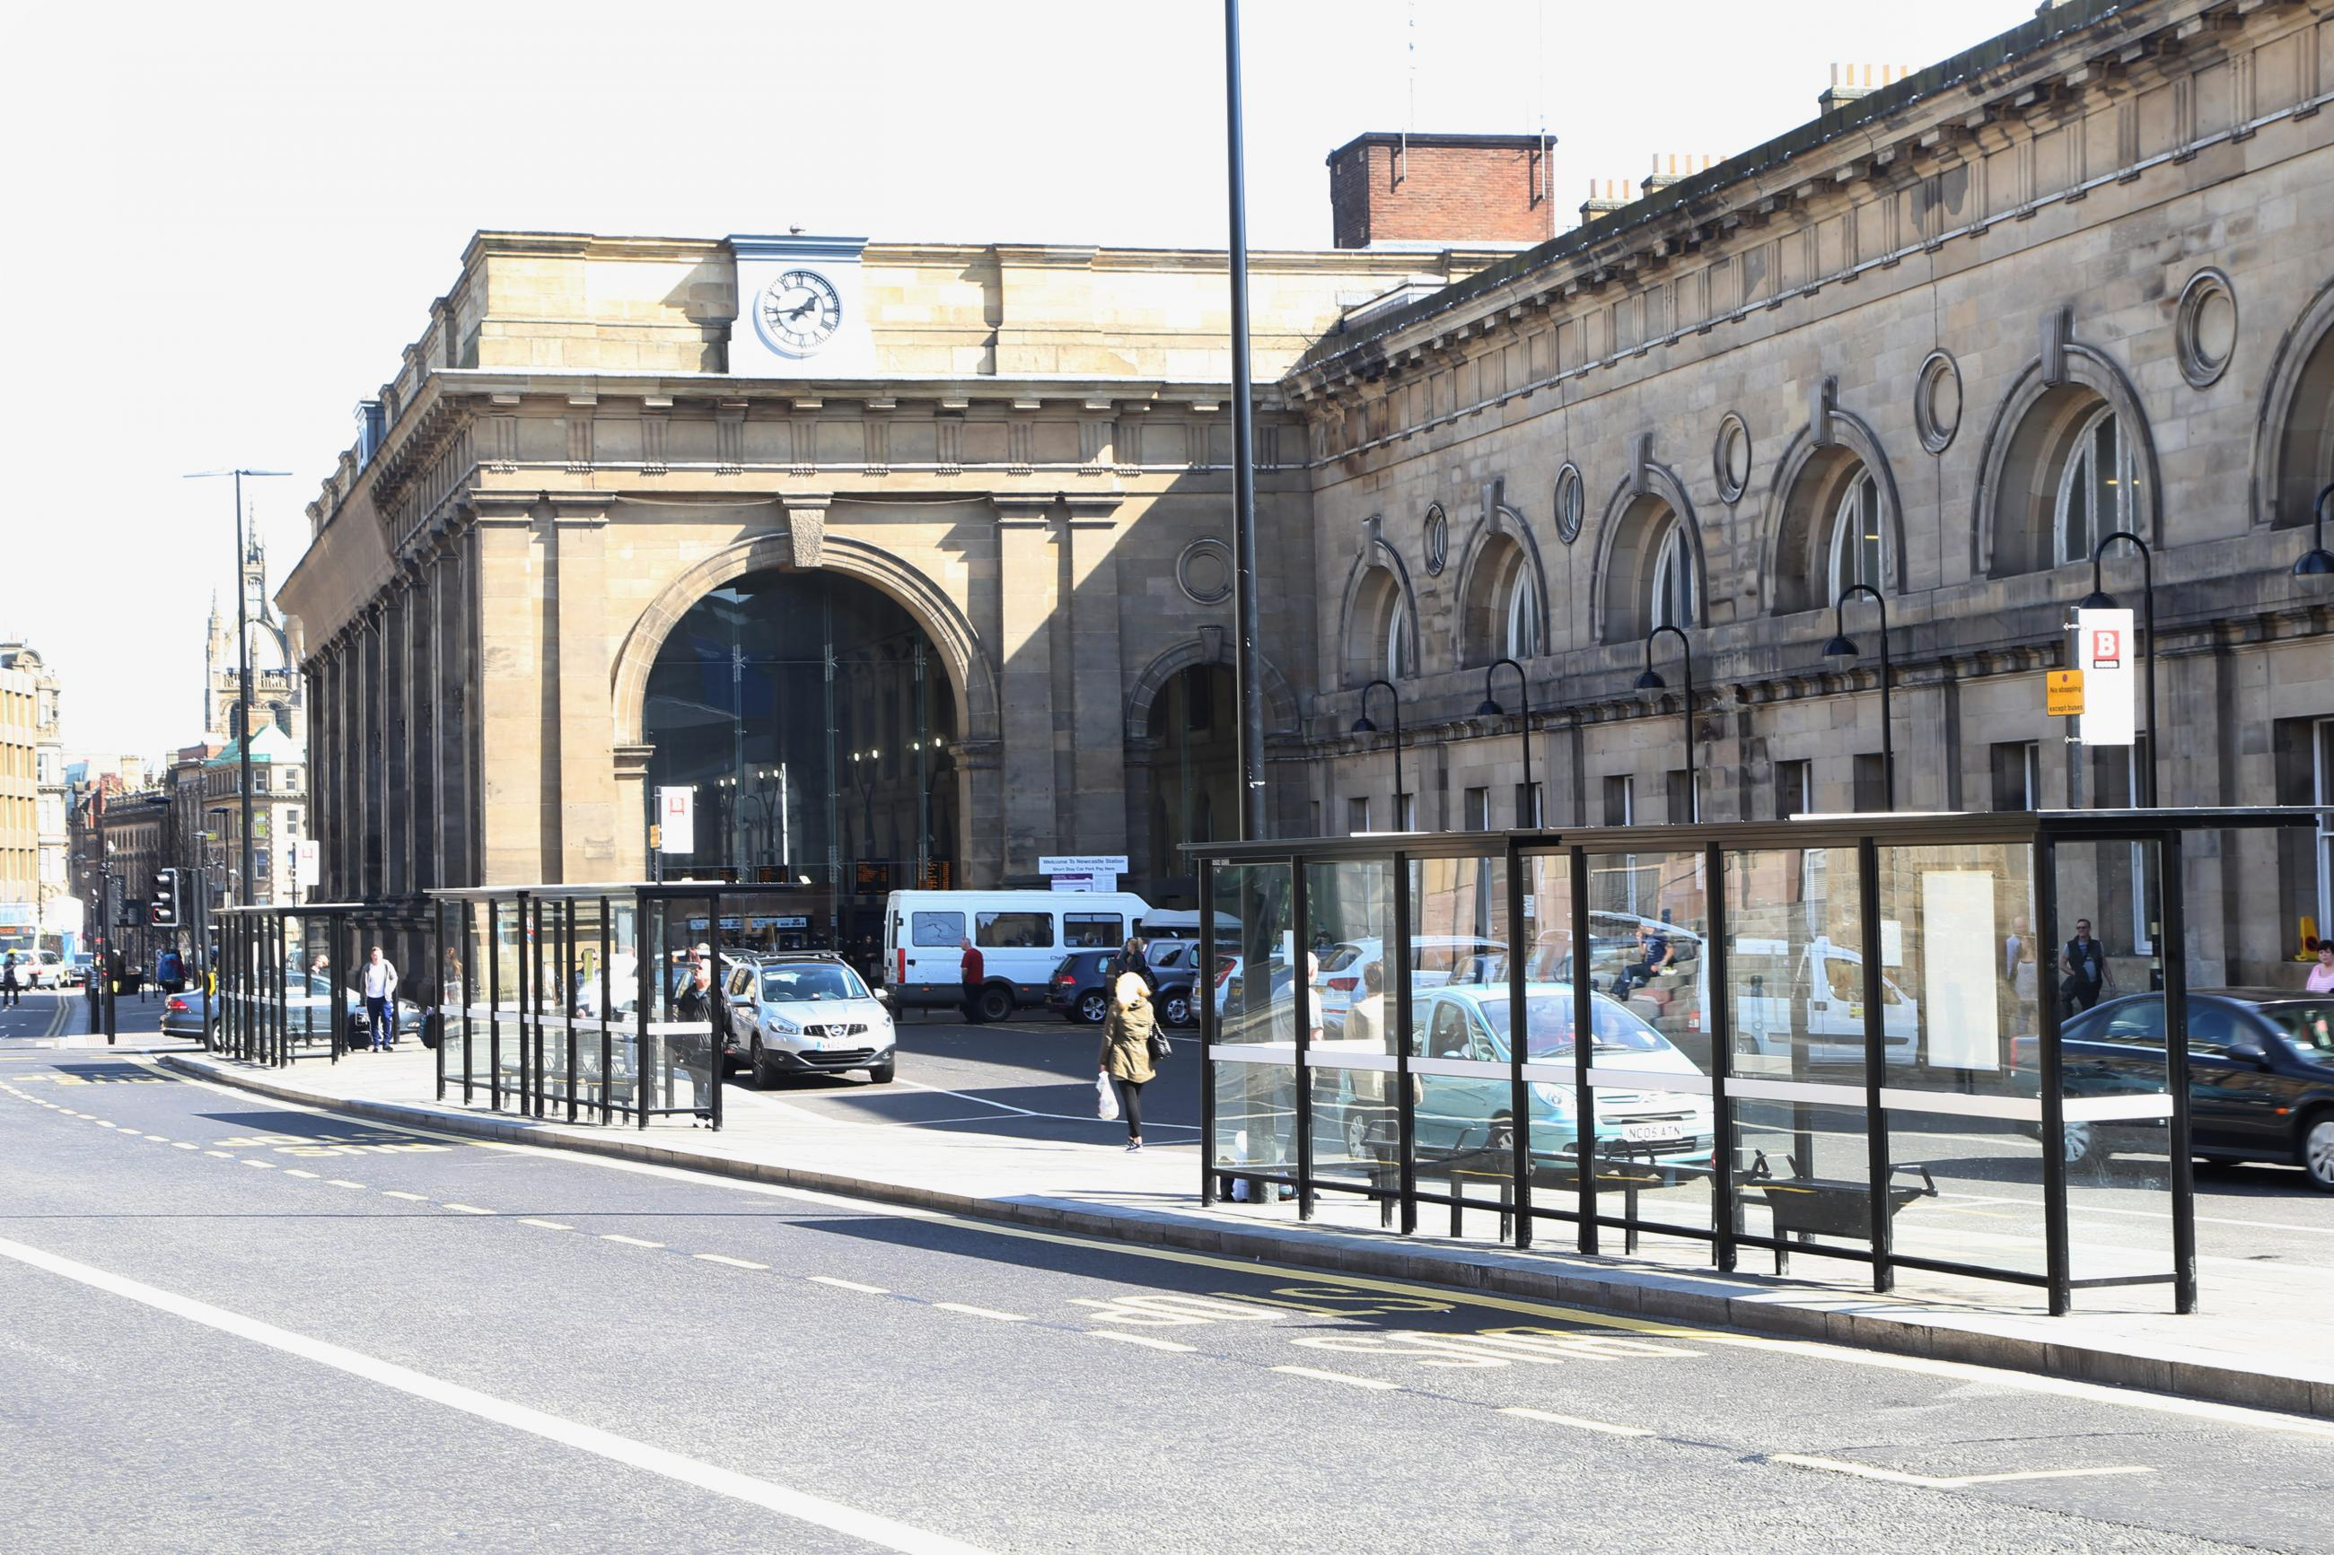
Newcastle Central Station
Onward connections via Tyne and Wear Metro and national rail network
No additional infrastructure required at station
Newcastle is key destination for existing/future employment, leisure, further education and retail opportunities

Slide 23
Business Case

Slide 24
Business Case
Developed in accordance with DfT guidance on Transport Business Cases
Working to ‘Project Speed’ and Network Rail ‘Pace’ initiatives
Accelerated through business case process
Service anticipated to generate 1.45m return journeys by 2039
Close alignment with local and national policy – NCC, NTC, TNE, TfN
Newcastle and Northumberland Park key destinations
Presents a compelling case for investment in the railway line
Very High Value for Money with BCR of 4.30

Slide 25
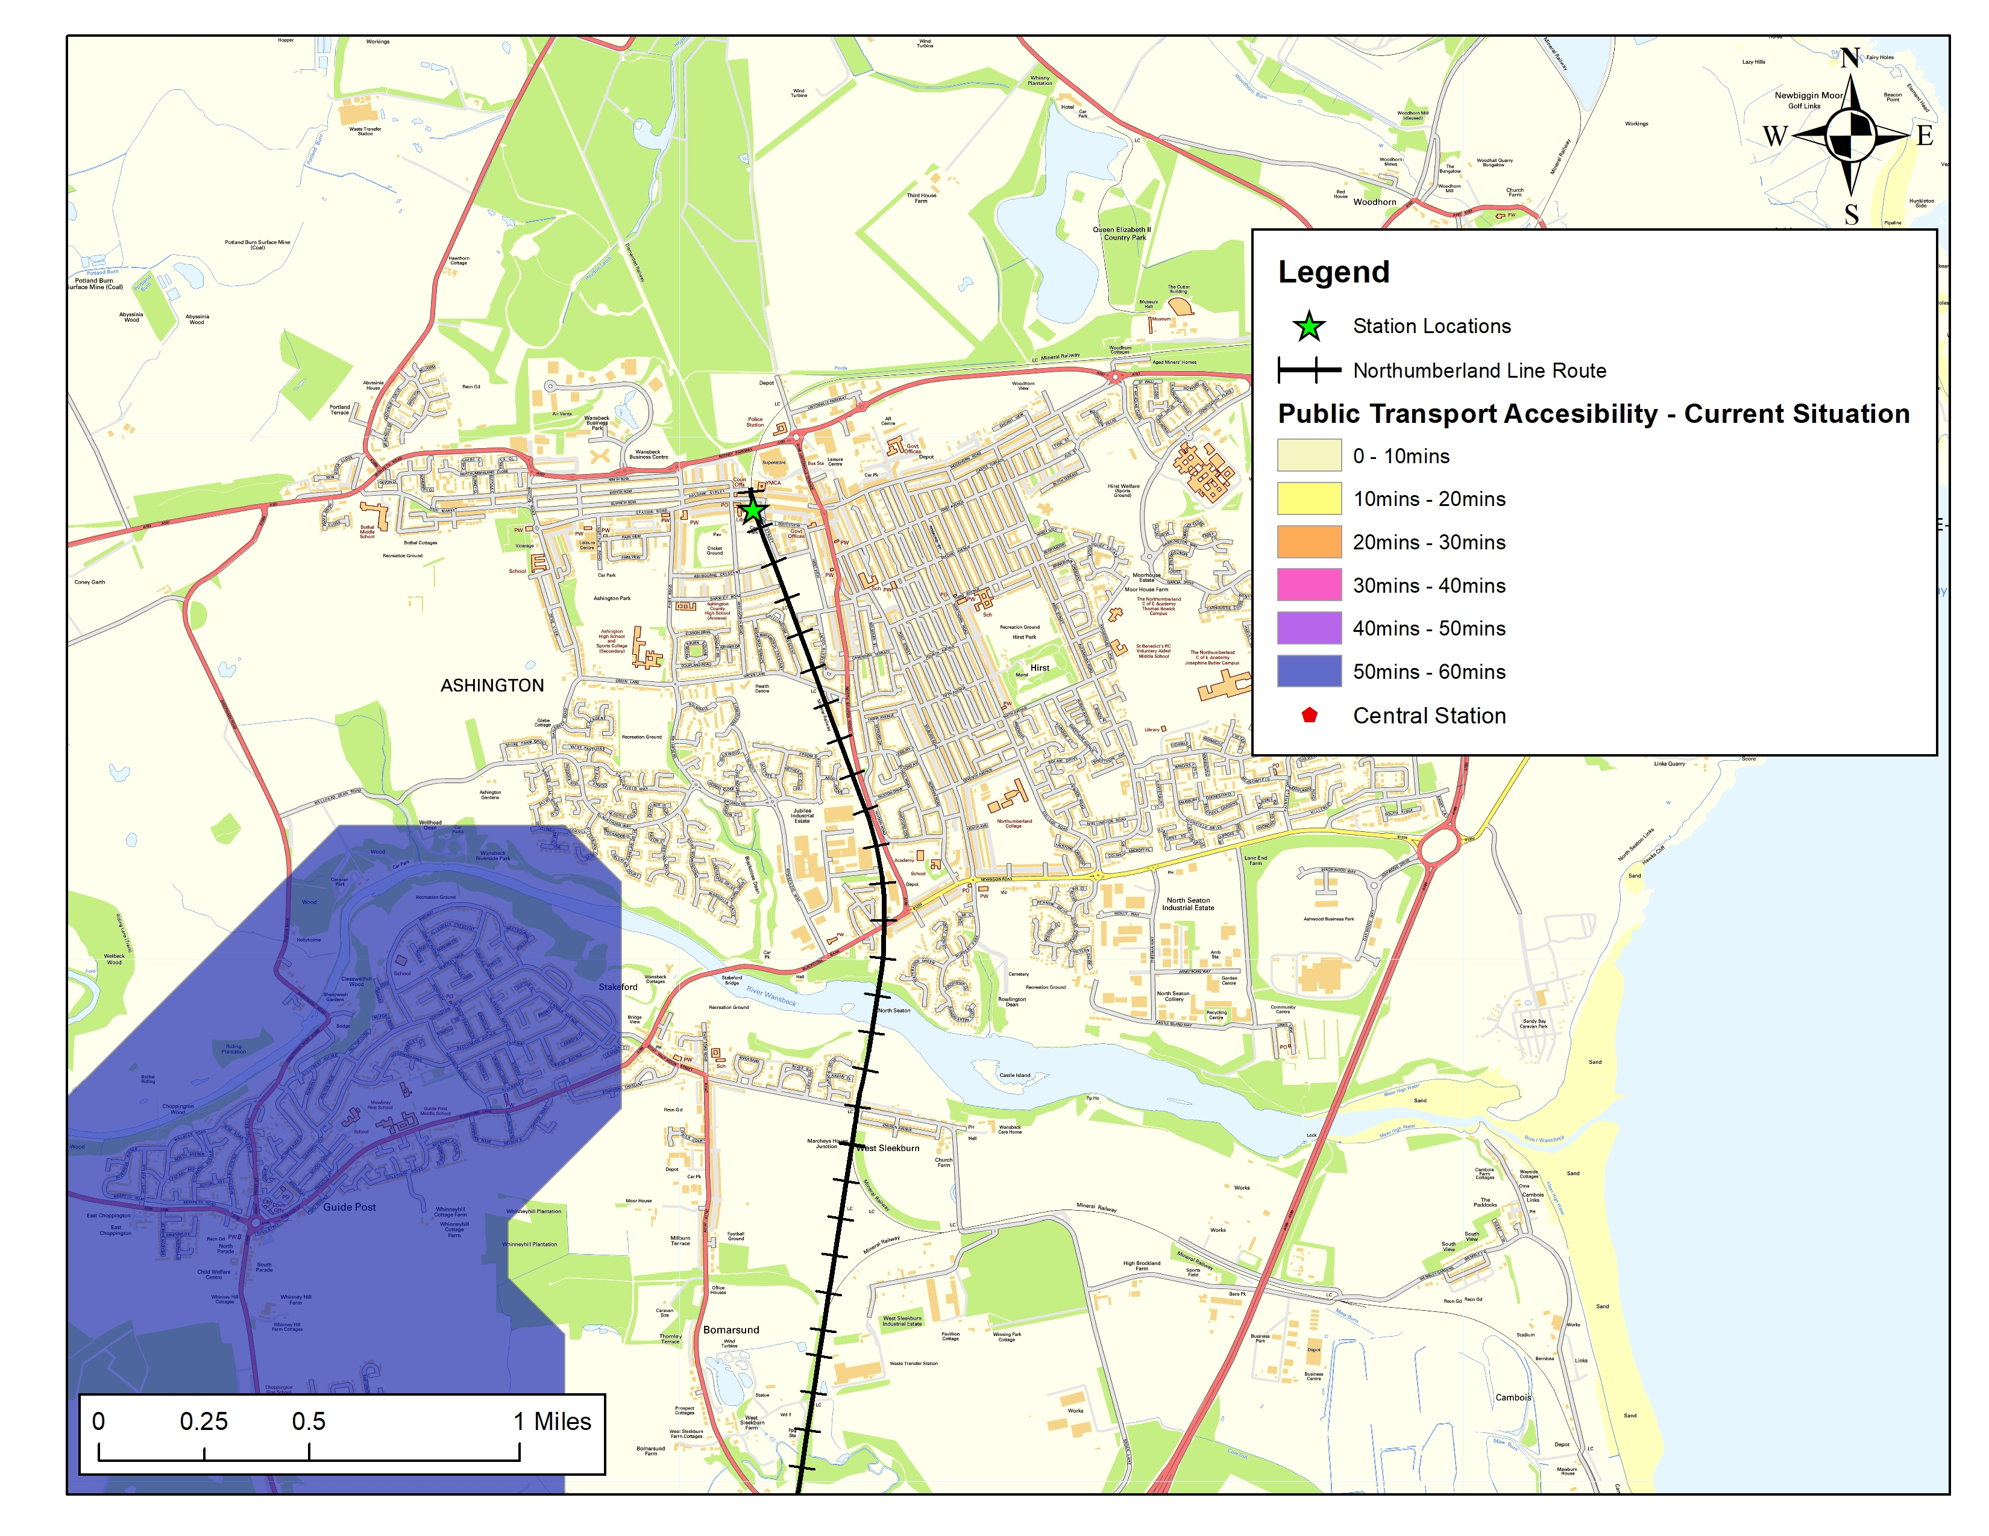
Public Transport Accessibility Ashington Baseline Situation

Slide 26
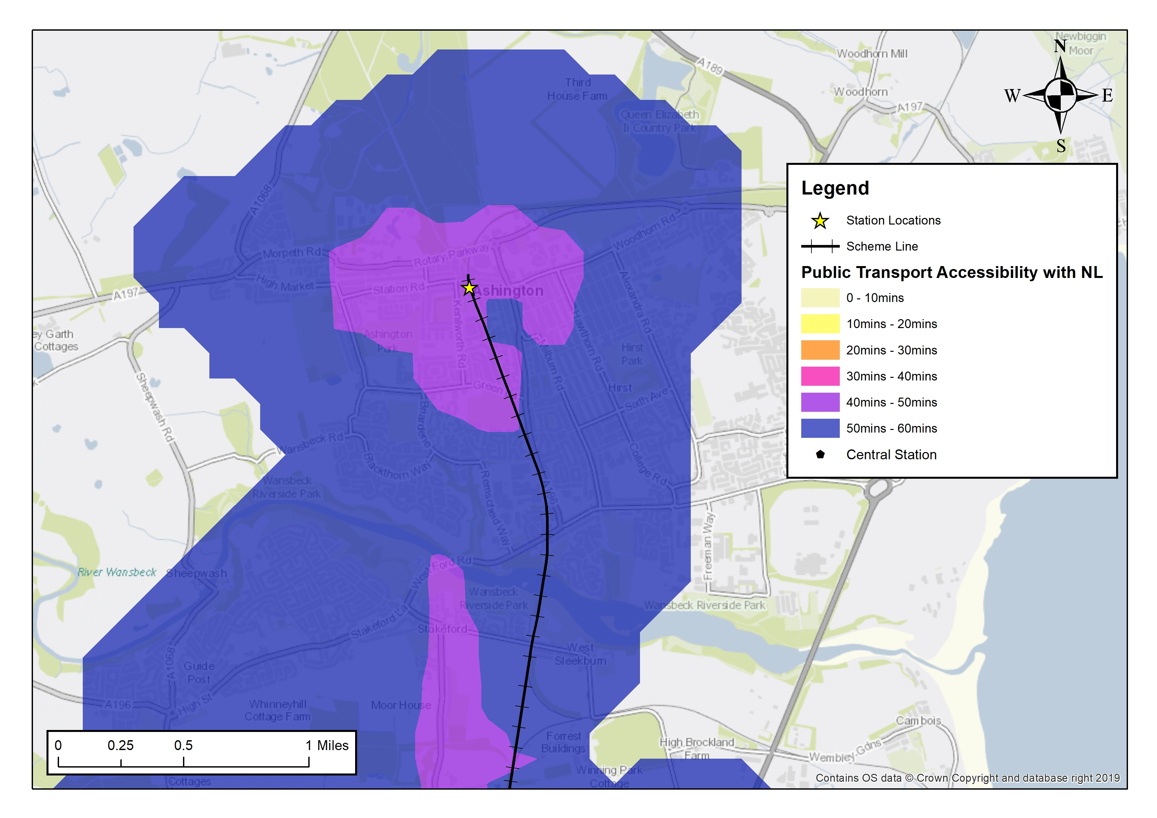
Public Transport Accessibility Ashington With scheme

Slide 27
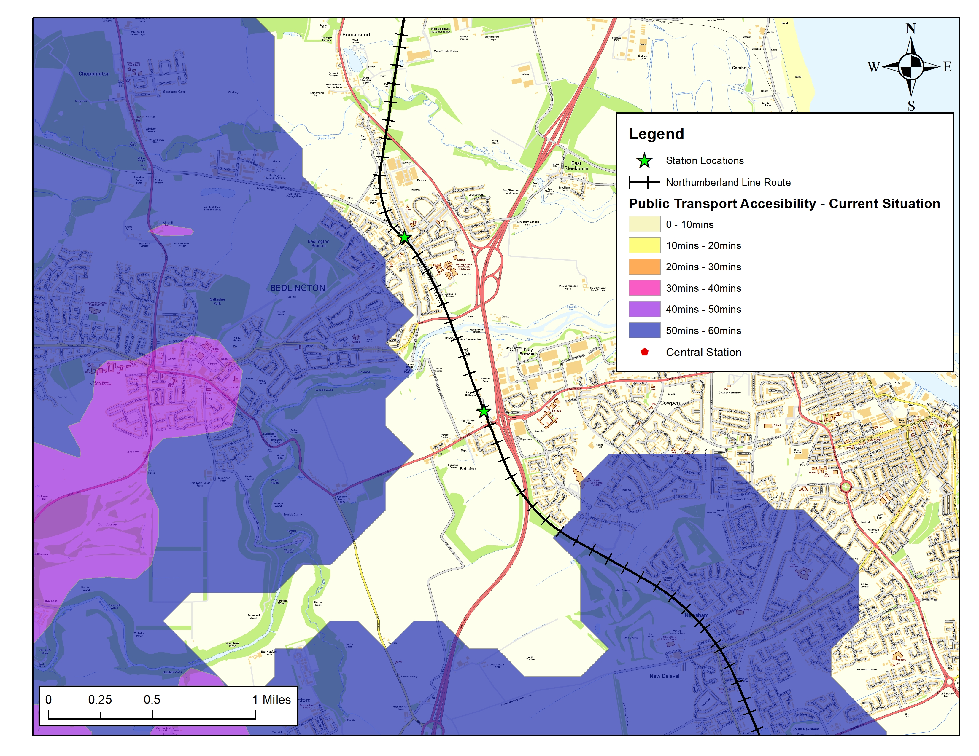
Public Transport Accessibility Blyth and Bedlington Baseline situation

Slide 28
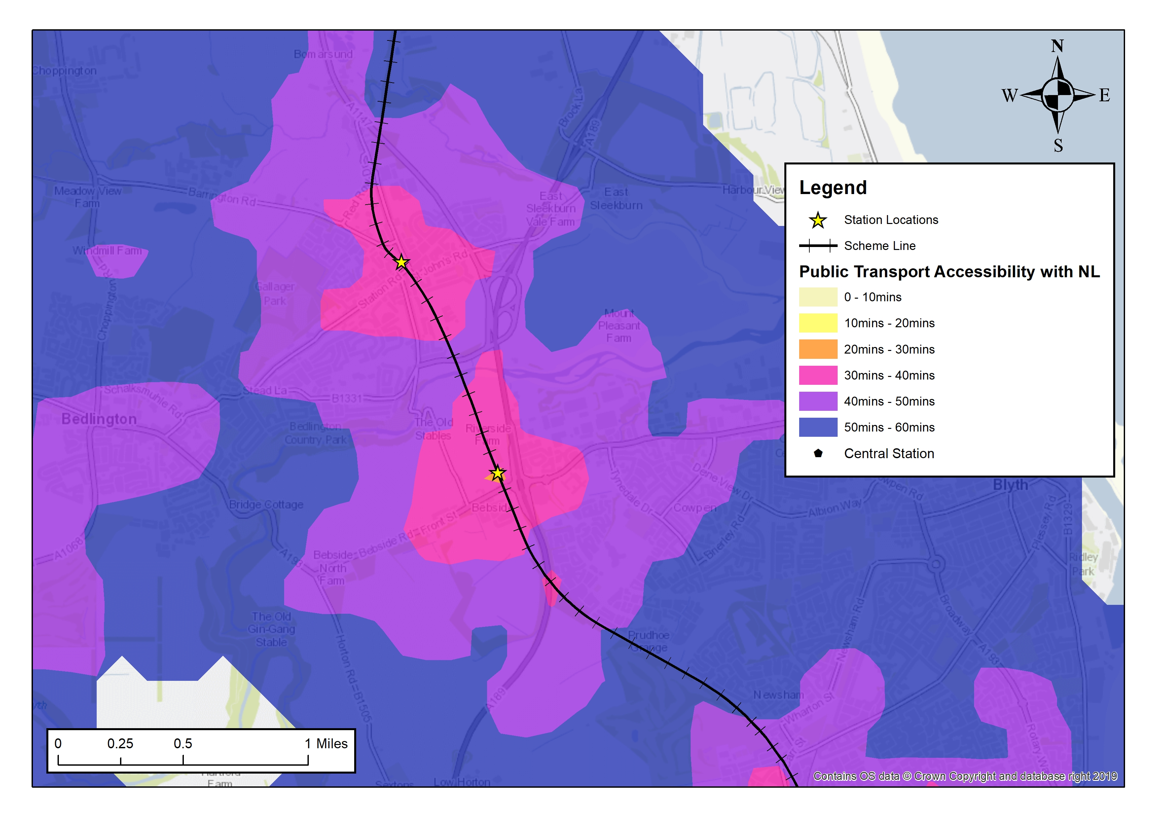
Public Transport Accessibility Blyth and Bedlington With scheme

Slide 29
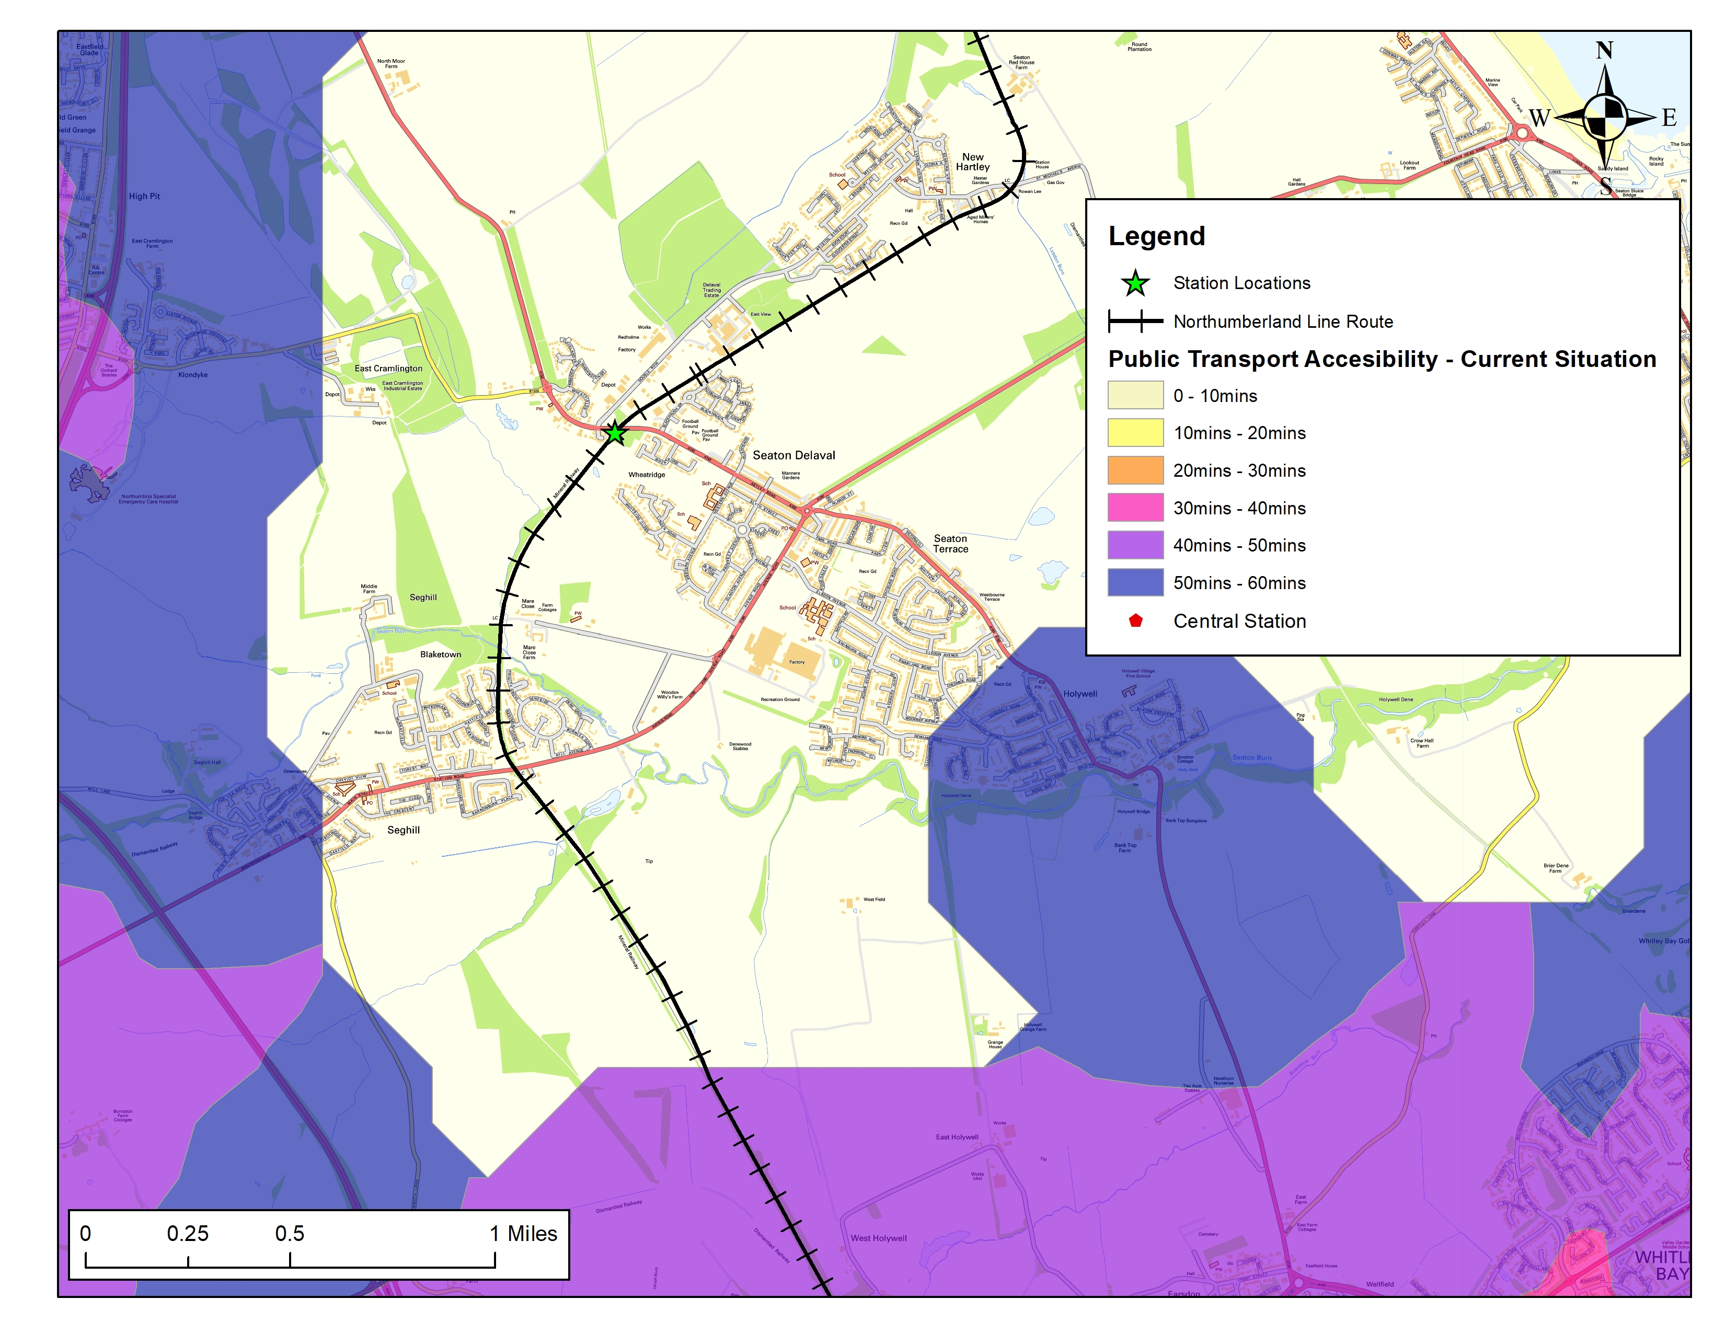
Public Transport Accessibility Seaton Valley Baseline situation

Slide 30
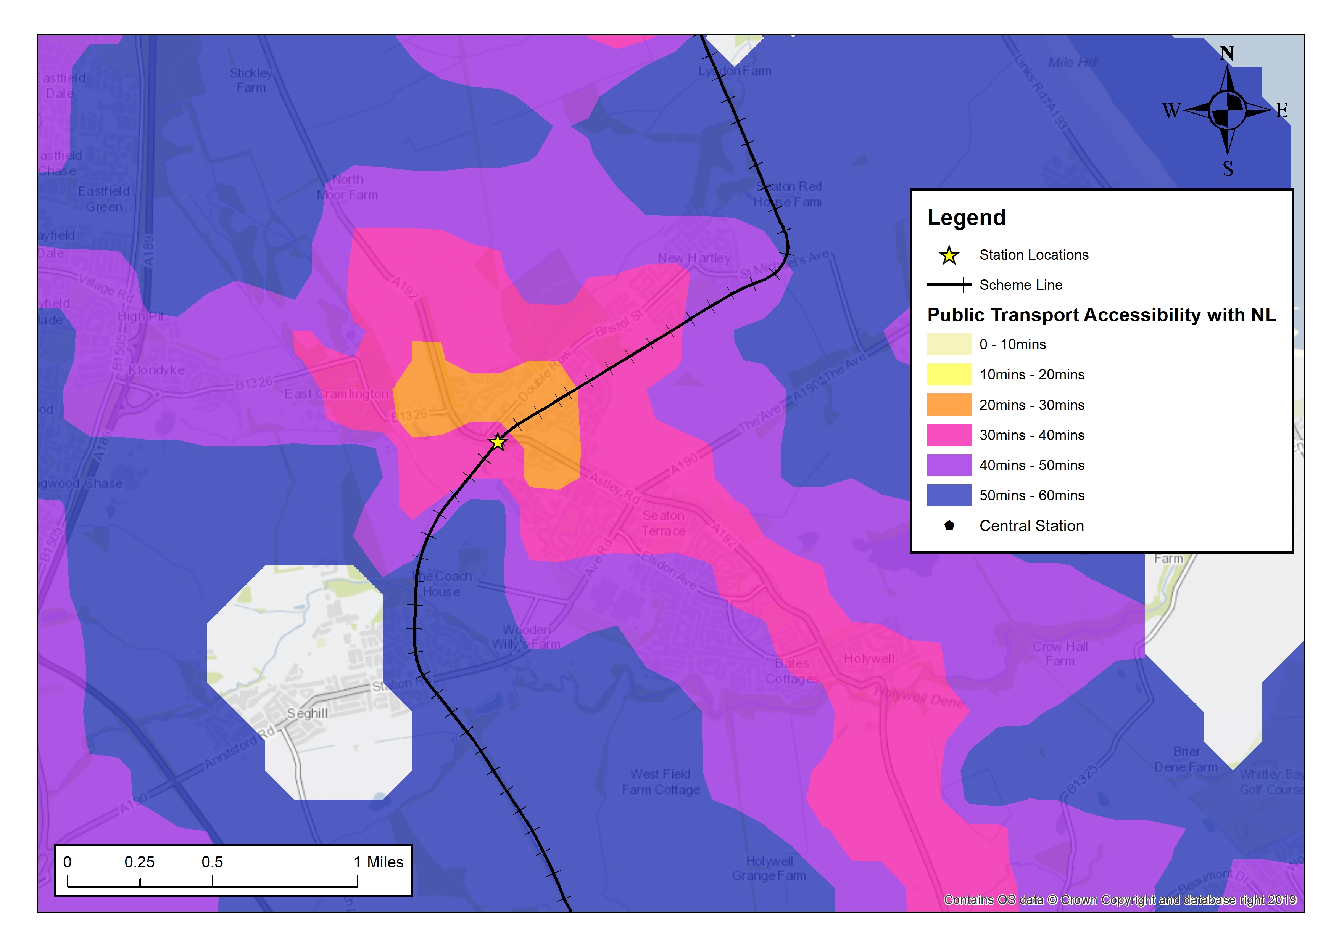
Public Transport Accessibility Seaton Valley With scheme

Slide 31
Social Value

Slide 32
Social Value
Primary focus of the scheme is to facilitate economic activity
The Northumberland Line is not just a transport infrastructure project
Priority to ensure that local communities and businesses are involved in the project
Delivering social value is not an add on, it’s the real impetus for the project
The project is promoting a range of social value initiatives

Slide 33
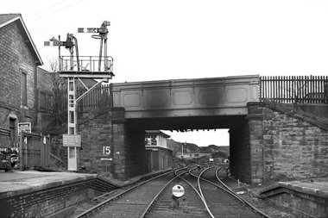
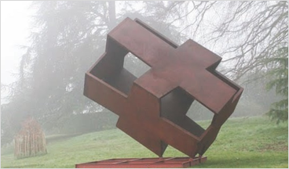
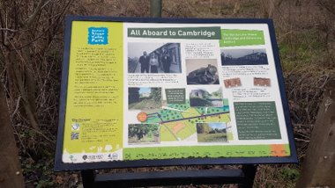
Arts Community Engagement Plan

Slide 34
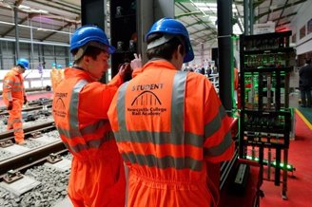
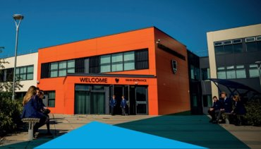
Academic Community Engagement Plan For inspiration; education; safety; and jobs

Slide 35
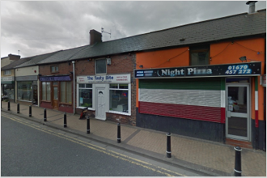
Business Community Engagement Plan

Slide 36
Funding

Slide 37
Funding
The Anticipated Final Cost of the scheme (as set out in OBC) is £161.92m
NCC authorised capital allocation of £27.218m
DfT RNEP contributions of £40.8m
Network Rail CP6 funding of £4.25m
Final Funding Request will be presented on completion of FBC

Slide 38
Funding
Scheme demonstrates very high value for money
The scheme is supported by the DfT and other key partners and has secured significant levels of financial contributions to date
The funding position is thus well advanced and the scheme is clearly capable of being funded.

Slide 39
Summary

Slide 40
Summary
The need for the Scheme has been fully justified. It has been developed to address a clearly identified need, that being to facilitate economic growth by improving transport connectivity thus reducing traffic congestion and addressing existing issues of social exclusion.
The business case presents a compelling case for investment representing very high value for money. Significant funding commitments have been secured and the Scheme is ready to proceed. I ask the Inspector to recommend the powers applied for.

